Slide 1

Project Title - Netflix Data Analysis
[Sumit Dayanand Sinha]
[AICTE Internship ID - STU677bfaca0a5091736178378]

Slide 2

PROBLEM STATEMENT
Netflix has become one of the most prominent global streaming platforms, continuously expanding its library with a mix of original productions and licensed content. However, with growing competition from platforms like Amazon Prime, Disney+, and regional OTT providers, Netflix must strategically analyze its content catalog to identify strengths, gaps, and opportunities.
The specific problem to be addressed in this project is 'Content Trends Analysis for Strategic Recommendations'. The aim is to uncover how Netflix’s content distribution (Movies vs. TV Shows, genres, and country contributions) has evolved over the years. This will enable the identification of key genres, audience preferences, and strategic insights into global content expansion.

Slide 3
Project Description
Analyze the distribution and growth of Movies and TV Shows on Netflix over the years.
Identify the most frequent genres and observe changes in their popularity.
Compare country-wise contributions to Netflix’s content base to assess global diversity.
Provide strategic recommendations for future content acquisition and production.
Significance of the Study
This analysis is significant for understanding Netflix’s content evolution and audience engagement patterns. By identifying popular genres and underrepresented regions, the study offers actionable insights that can help Netflix make data-driven business decisions. Such findings are valuable for:
Enhancing content strategy and balancing global vs. local productions.
Recognizing market trends and regional viewer interests.
Supporting strategic investments in specific content types and countries.

Slide 4

WHO ARE THE END USERS?
Netflix Management and Strategy Team
Netflix Content and Production Teams
Netflix Data Analytics and Insights Department
Data Analysts and Data Scientists (in the OTT or media industry)
Academic Researchers and Students (studying data analytics or media trends)
Business Analysts and Market Researchers

Slide 5

Technology Used
Python
Jupyter Notebook
Google colab
Matplotlib
numpy

Slide 6
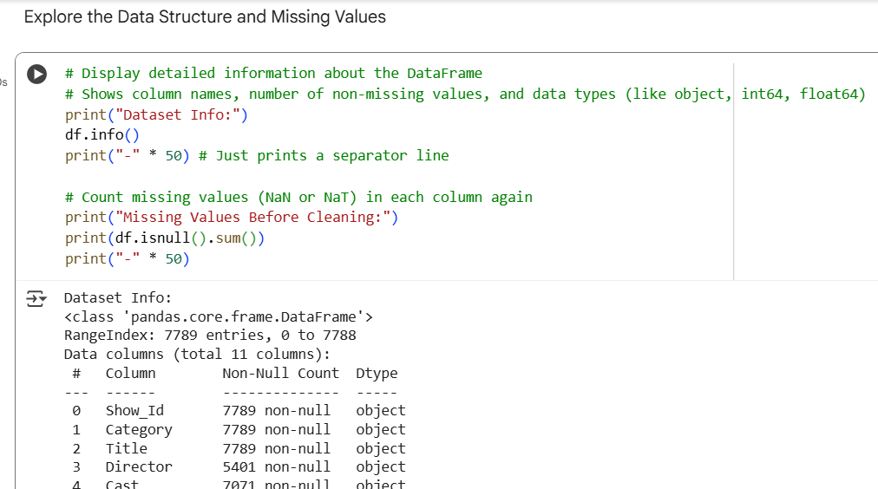
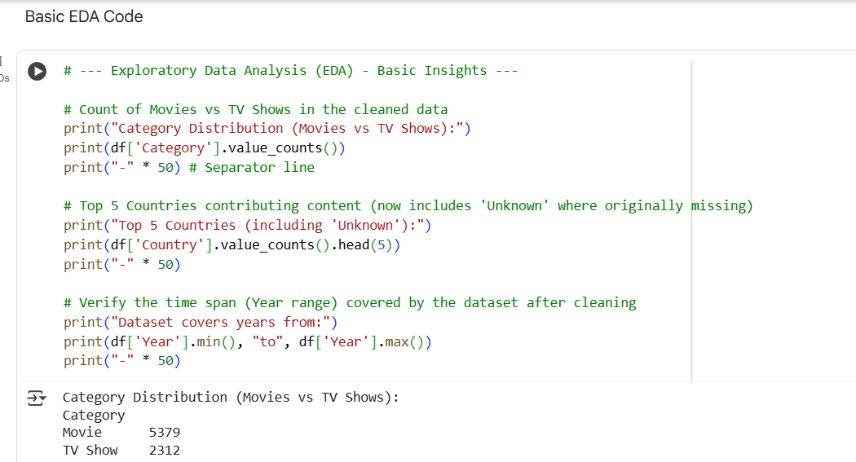
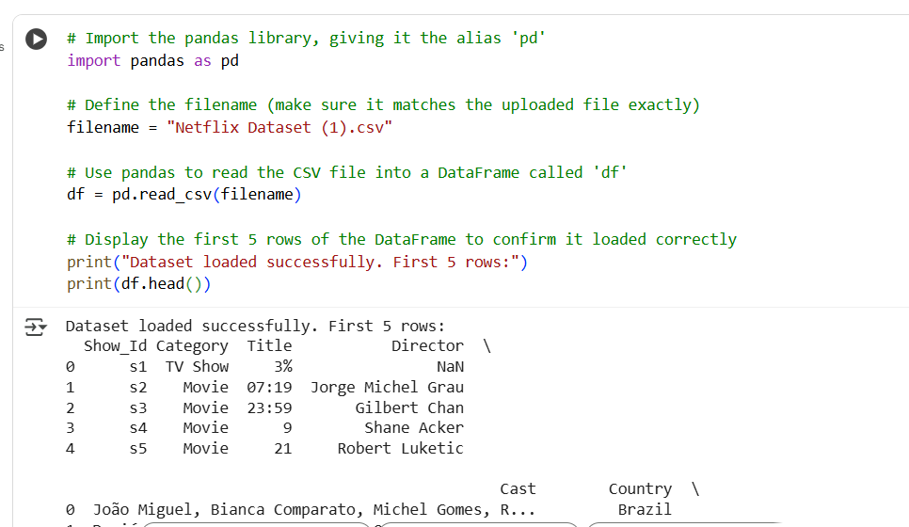
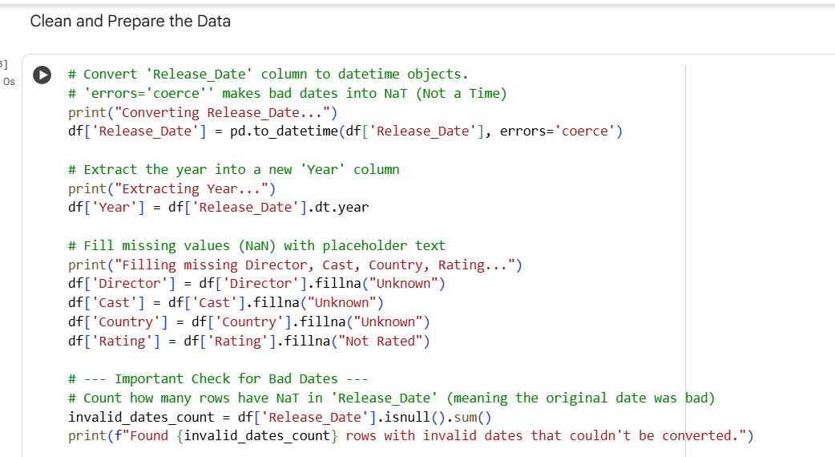
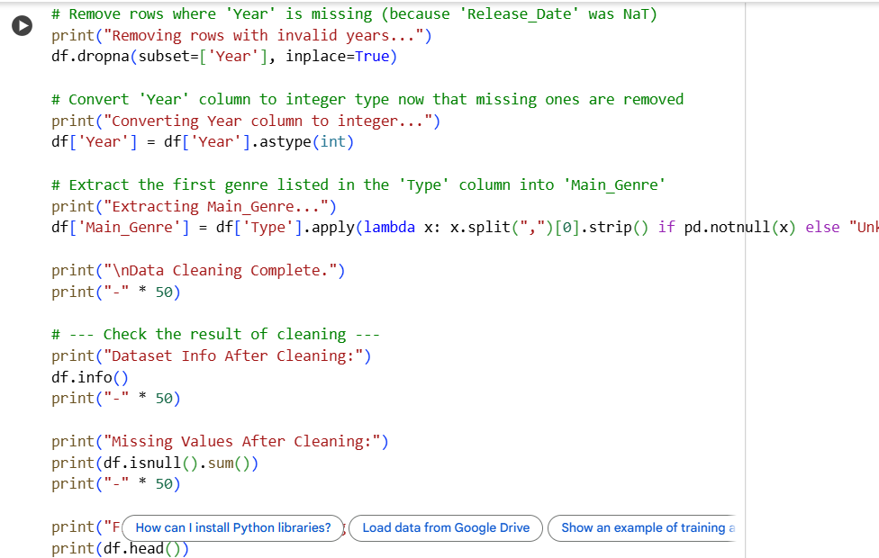
RESULTS1 – Code of Import ,preprocessing, clean and prepare the data and Apply EDA
Paste the screen shot of your code

Slide 7
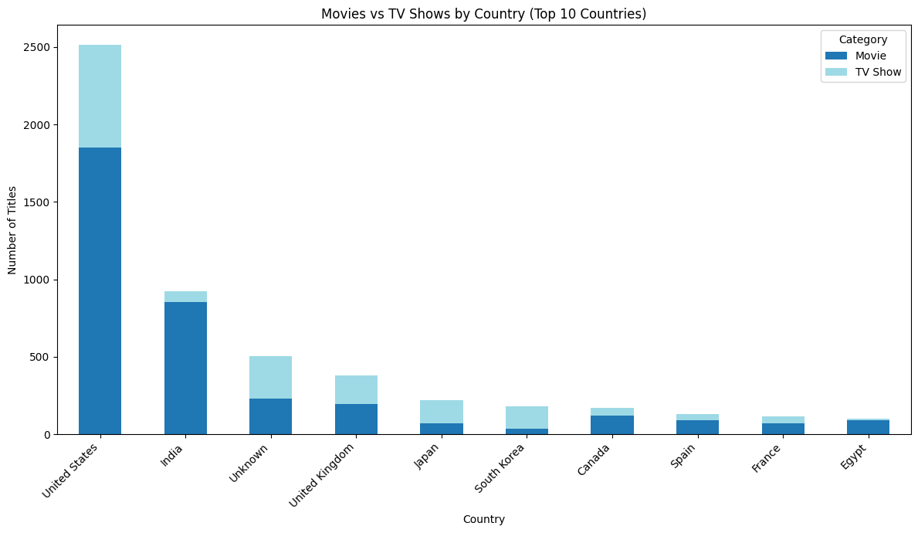
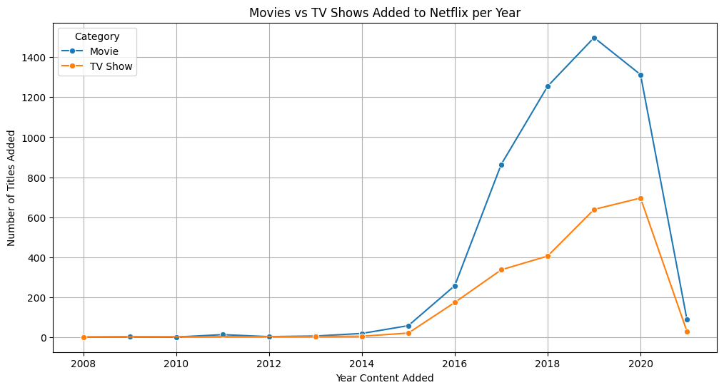
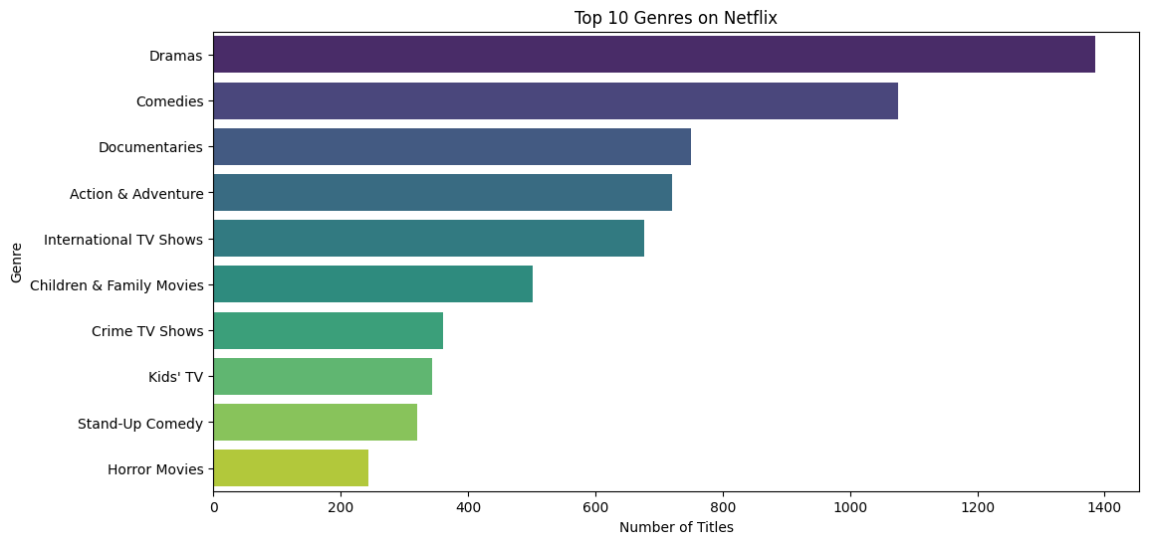
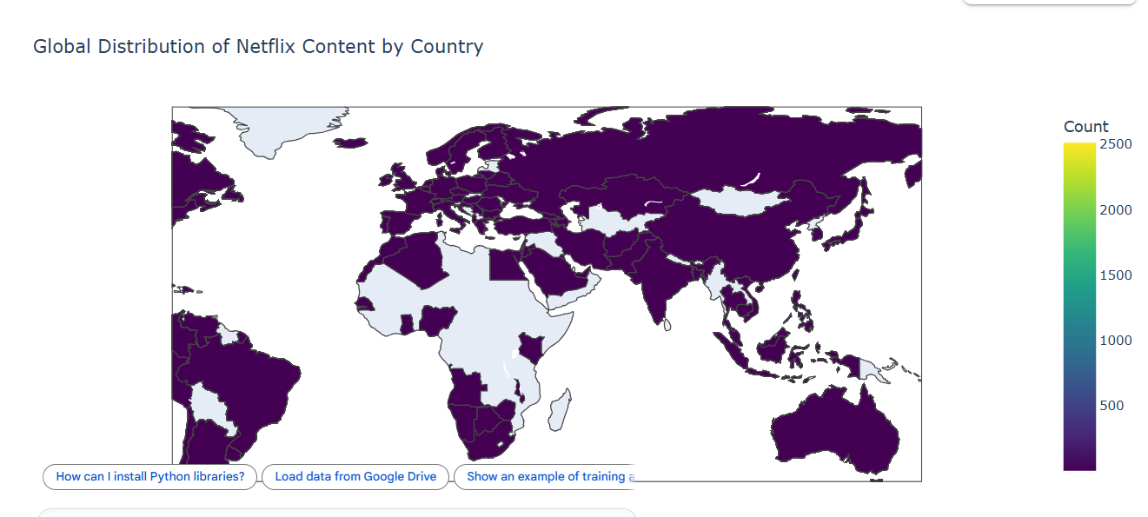
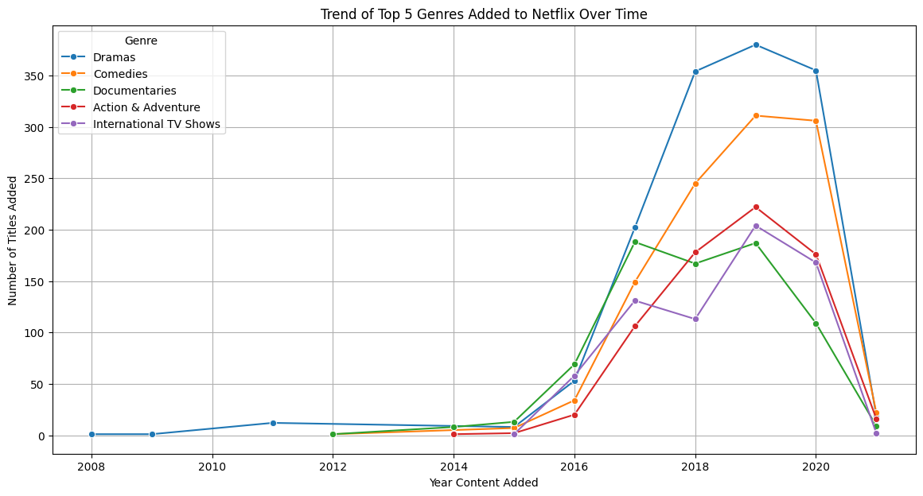
RESULTS2 – screenshot of output graph
Add screen shot of graph

Slide 8
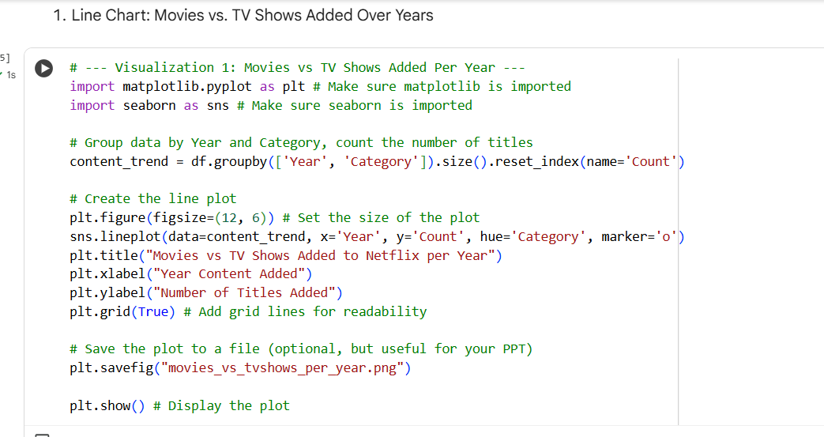
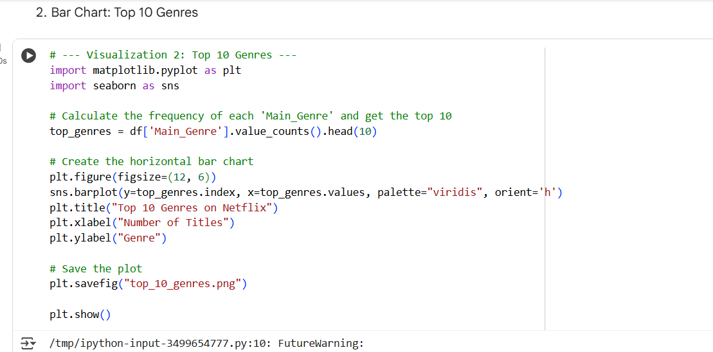
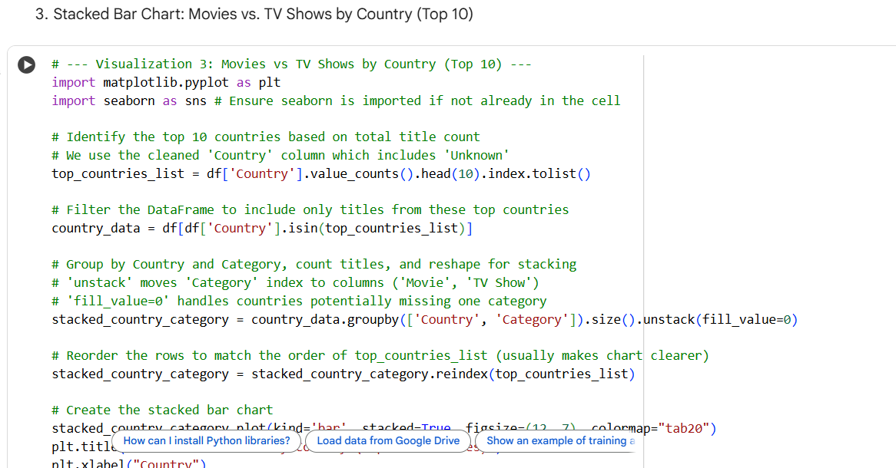
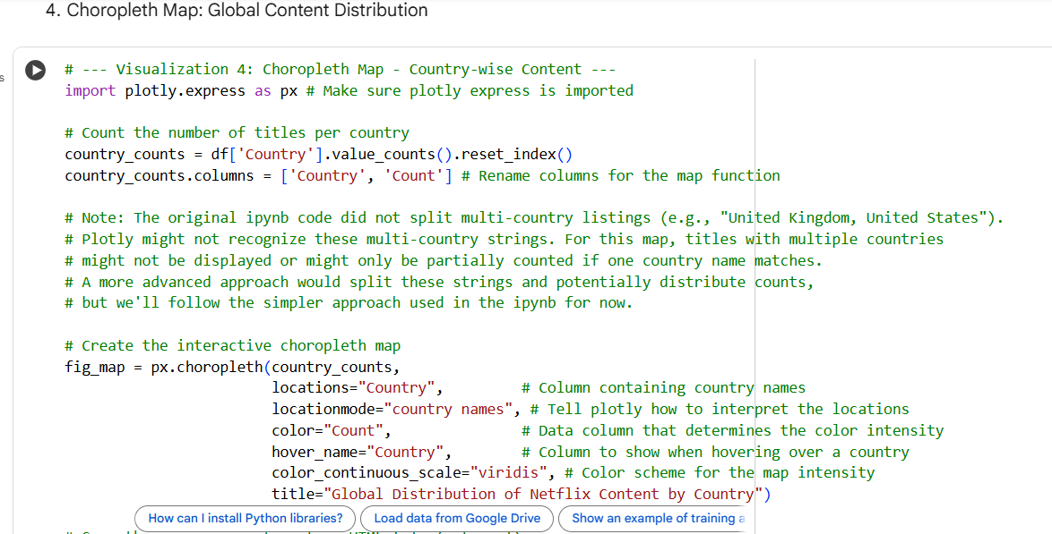
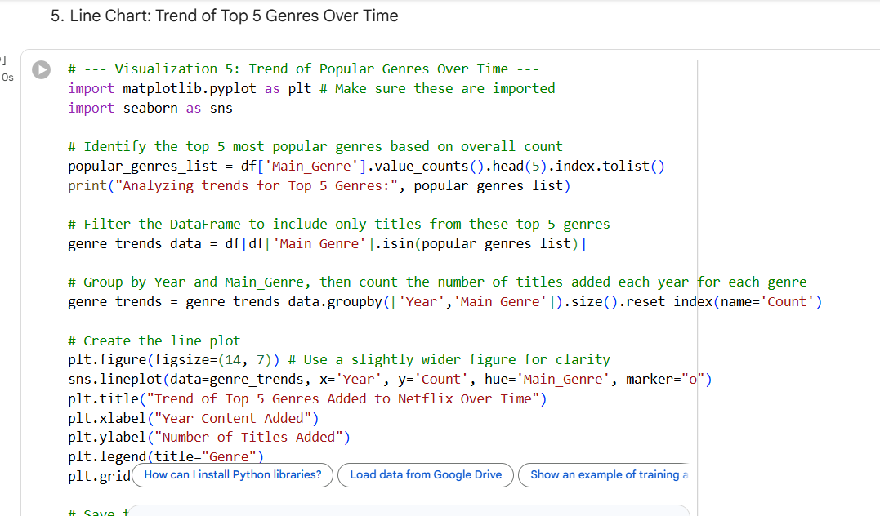
RESULTS3- screenshot of code of output of graph
Paste the screen shot of your code​

Slide 9
GitHub repository
[https://github.com/Sumit0919/VOIS_AICTE_Oct2025_MajorProject_Sumit_Sinha08 ]
Create github repository with format VOIS_AICTE_Oct2025_MajorProject_YourName

Slide 10

Getting started with Basics of Python Certificate

Slide 11
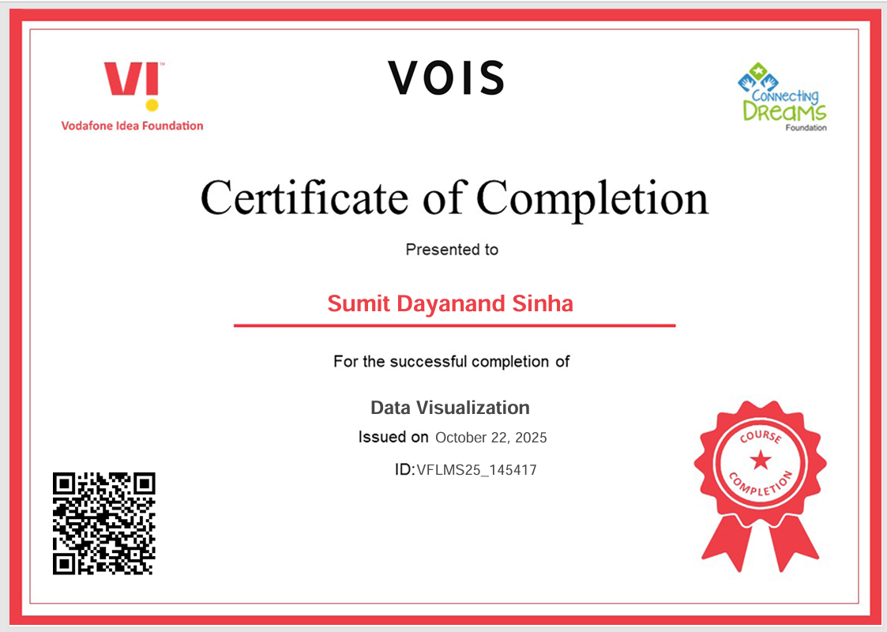
Data Visualization Certificate

Slide 12
Thank you
.
.

